Slide 1
Transparent Offloading and Mapping (TOM):
Enabling Programmer-Transparent Near-Data Processing in GPU Systems
Conference : ISCA-2016
Author : Onur Mutlu, Kevin Hsieh, Nandita Vijaykumar, Gwangsun Kim……
Research unit : Carnegie Mellon University, NVIDIA, KAIST, ETH Zürich……

Slide 2
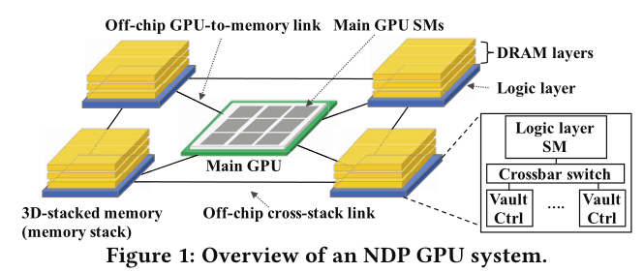
Background
Near-data accelerators(NDA) improve the energy efficiency and performance of computing systems
Recent work demonstrates promising performance and energy efficiency benefits from using near-data processing in GPU systems. This system consists of 1) multiple 3D-stacked memories, called memory stacks, each of which has one or more streaming multiprocessors (SMs) on its logic layer, and 2) the main GPU with multiple SMs.

Slide 3
Problem
Reducing data traffic between the memory stacks and the main GPU
Which operations should be executed on the SMs in the main GPU versus the SMs in the memory stack?
For example, memory-intensive blocks of instructions could benefit from executing at the logic layer of memory stacks that hold the data they access, while compute-intensive portions could benefit from remaining on the main GPU. Although programmers may have such knowledge, it would be a large burden for them to designate the most appropriate execution engine for all parts of the program, which may change dynamically due to program phase behavior and different input sets.
How should data be mapped to different 3D memory stacks?
The efficiency of an NDP operation primarily depends on whether the data accessed by the offloaded operation is located within the same memory stack. We thus need to map data in a way that:
1) maximizes the code/data co-location for NDP operations
2) maximizes bandwidth utilization for the code executing on the main GPU.
Doing so is challenging because different code blocks and different threads in a program access different parts of data structures at different times during program execution. Determining which part of memory is accessed by which code block instances is difficult, and requiring the programmer to do this places a large burden on the programmer.

Slide 4
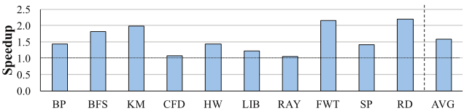
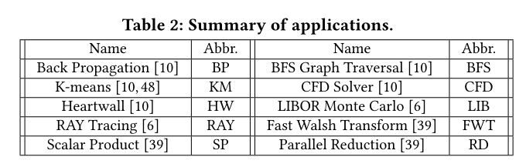
Motivation
Deciding which code to offload
Most prior research on near-data processing requires the programmer to identify and specify which code will be run close to memory and can ignore the memory intensity of the code. These approaches lead to increased programmer effort, or suboptimal performance by executing some compute-intensive code on the 3D-stack logic layer. In contrast, our approach identifies the candidate code blocks for offloading via static compile-time analysis that maximizes memory bandwidth savings.
Figure 2: Ideal speedup with near-data processing
With an idealized system where there is no overhead for offloading code blocks and where all offloaded code and data are co-located, our static approach has the potential to improve performance by 1.58×on average (up to 2.19×) across a range of 10 memory intensive GPGPU workloads.

Slide 5
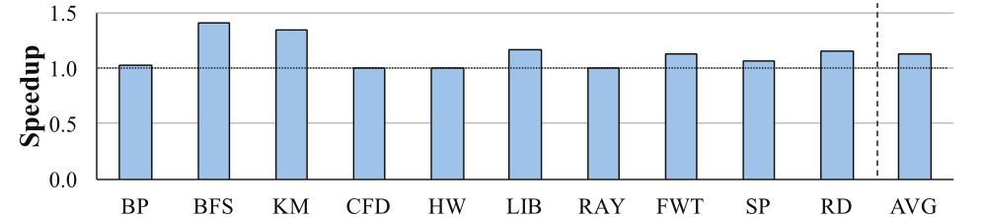
Motivation
Co-locating the offloaded computation with its data
The mapping of memory to different stacks is determined by several dynamic components, e.g., the host-side driver, GPU runtime, memory controller, etc.
Figure 3: Effect of ideal memory mapping on near-data processing performance.
Figure 3 shows how an ideal mapping, which simply uses the best two consecutive address bits to map memory pages to memory stacks, can improve the performance of an NDP system. The graph shows that such a simple ideal address mapping of data to memory stacks, which maximizes offloaded code/data co-location, improves performance by 13% on average compared to a state-of-the-art GPU memory mapping policy.

Slide 6
Solution
We propose a new compiler-based mechanism to select instructions to offload to near-data compute units, without requiring any programmer intervention. Our mechanism identifies the best candidate code blocks for offloading by statically estimating the potential memory bandwidth savings for different code blocks. We propose a new runtime mechanism that decides whether or not the selected instructions should be offloaded based on system conditions.
We propose a new programmer-transparent data mapping mechanism to co-locate offloaded code and data in the same memory stack by exploiting predictability in memory access patterns in offloaded code blocks. Our mechanism retains the memory mapping for all other data to maximize memory bandwidth of code executing on the main GPU.

Slide 7
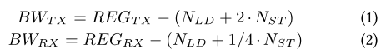
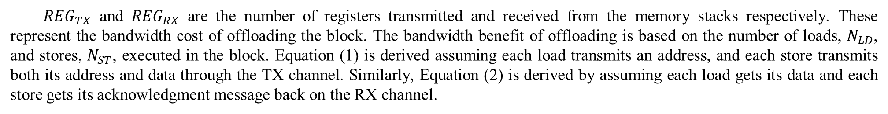
Technique —— Identification of Offloading Candidates
Estimating the memory bandwidth cost-benefit
Load instructions send addresses through the transmit channels (TX, from the GPU to the memory stack), and receive data back on the receive channels (RX, from the memory stack to the GPU). Store instructions send store addresses and data through the TX channels, and get the acknowledgment messages back from the RX channels.
${REG}_{TX}$ and ${REG}_{RX}$ are the number of registers transmitted and received from the memory stacks respectively. These represent the bandwidth cost of offloading the block. The bandwidth benefit of offloading is based on the number of loads, $N_{LD}$, and stores, $N_{ST}$, executed in the block. Equation (1) is derived assuming each load transmits an address, and each store transmits both its address and data through the TX channel. Similarly, Equation (2) is derived by assuming each load gets its data and each store gets its acknowledgment message back on the RX channel.

Slide 8
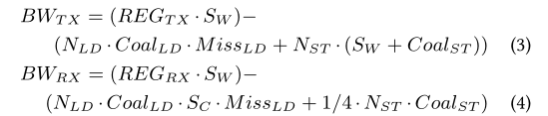
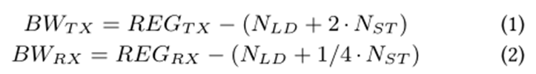
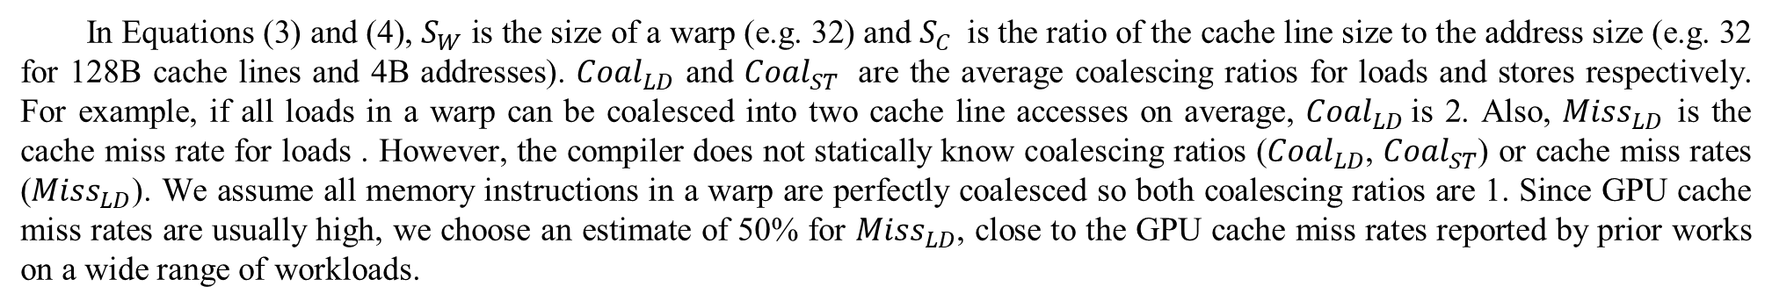
Technique —— Identification of Offloading Candidates
Identification of Offloading Candidates
In a GPU, threads are executed in lock-step warps, so it is straightforward for the hardware to offload code block instances at the granularity of a warp as opposed to the granularity of a single thread. In reality, loads and stores are coalesced by the load-store unit and caches. Furthermore, for loads, the sizes of address and data are different because data is fetched at cache line granularity. To address these issues, we estimate the bandwidth change at warp granularity as follows:
In Equations (3) and (4), $S_{W}$ is the size of a warp (e.g. 32) and $S_{C}$is the ratio of the cache line size to the address size (e.g. 32 for 128B cache lines and 4B addresses). ${Coal}_{LD}$ and ${Coal}_{ST}$ are the average coalescing ratios for loads and stores respectively. For example, if all loads in a warp can be coalesced into two cache line accesses on average, ${Coal}_{LD}$is 2. Also, ${Miss}_{LD}$is the cache miss rate for loads . However, the compiler does not statically know coalescing ratios (${Coal}_{LD}$, ${Coal}_{ST}$) or cache miss rates (${Miss}_{LD}$). We assume all memory instructions in a warp are perfectly coalesced so both coalescing ratios are 1. Since GPU cache miss rates are usually high, we choose an estimate of 50% for ${Miss}_{LD}$, close to the GPU cache miss rates reported by prior works on a wide range of workloads.

Slide 9
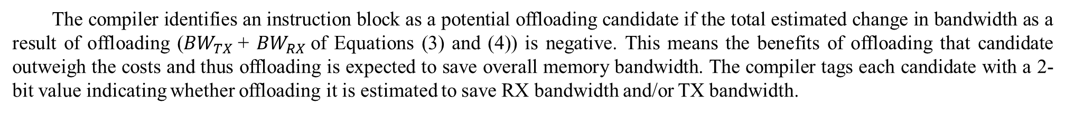
Technique —— Identification of Offloading Candidates
Offloading candidate block identification
The compiler identifies an instruction block as a potential offloading candidate if the total estimated change in bandwidth as a result of offloading (${BW}_{TX}$+ ${BW}_{RX}$of Equations (3) and (4)) is negative. This means the benefits of offloading that candidate outweigh the costs and thus offloading is expected to save overall memory bandwidth. The compiler tags each candidate with a 2-bit value indicating whether offloading it is estimated to save RX bandwidth and/or TX bandwidth.
Loops and conditional offloading candidates
In candidate blocks that encapsulate a loop structure, the loop’s execution count is a multiplier into the number of loads/stores
for the block’s bandwidth change calculation. There are three cases for the compiler to handle a loop.
1、If the loop trip count can be determined statically, the compiler uses it to determine whether or not it is an offloading candidate. 2、If the loop trip count can be determined before entering the loop at runtime, the compiler marks the corresponding loop as a “conditional offloading candidate”. The compiler then provides the condition as a hint to the hardware. Using this hint, hardware decides whether or not to offload the candidate at runtime. For example, the condition of offloading can be a certain register’s value (e.g., the loop count) being greater than some threshold. Hardware offloads these conditional offloading candidates only when the condition holds true.
3、If the loop trip count is determined during execution, the compiler conservatively assumes the count to be one and makes the offloading decision based on the loop body. If offloading the loop body is beneficial, the loop is marked as an unconditional offloading candidate.

Slide 10
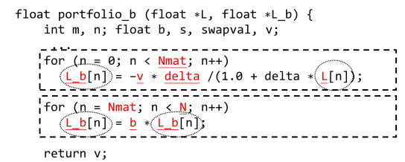

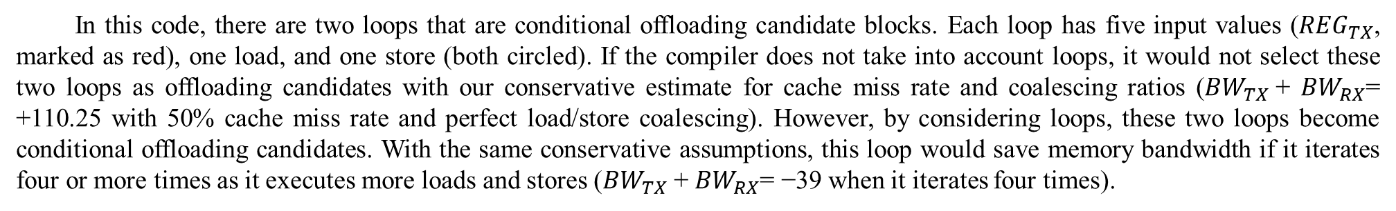
Technique —— Identification of Offloading Candidates
Offloading candidate block examples
In this code, there are two loops that are conditional offloading candidate blocks. Each loop has five input values (${REG}_{TX}$, marked as red), one load, and one store (both circled). If the compiler does not take into account loops, it would not select these two loops as offloading candidates with our conservative estimate for cache miss rate and coalescing ratios (${BW}_{TX}$+ ${BW}_{RX}$= +110.25 with 50% cache miss rate and perfect load/store coalescing). However, by considering loops, these two loops become conditional offloading candidates. With the same conservative assumptions, this loop would save memory bandwidth if it iterates four or more times as it executes more loads and stores (${BW}_{TX}$+ ${BW}_{RX}$= −39 when it iterates four times).
Figure 4: Example offloading candidate blocks from LIBOR Monte Carlo.

Slide 11

Technique—— Programmer-transparent Data Mapping
Memory access pattern analysis
We observe that a significant fraction of offloading candidates exhibit a very predictable access pattern: fixed offset, which means accesses are separated with a constant address offset/distance from each other. Such accesses are predictable and can be used to map memory chunks with that offset onto the same stack. Furthermore, when the offset between accesses has a factor that is a power of two, some least significant bits in the accessed addresses are always the same. Therefore, we can ensure all accesses go to the same memory stack if we use only the least significant N bits to determine the stack mapping. For example, the first loop in Figure 4 accesses two arrays with the same index, and their offset is solely determined by the distance between the arrays’ base addresses. As memory is allocated at a page granularity, which is a power of two value, this distance usually has a factor that is a power of two.
Figure 4: Example offloading candidate blocks from LIBOR Monte Carlo.

Slide 12
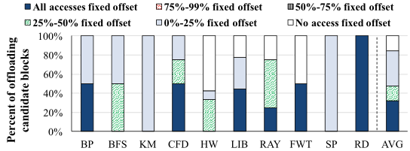
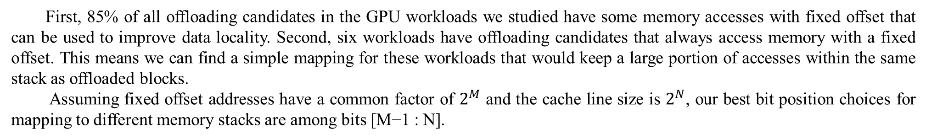
Technique—— Programmer-transparent Data Mapping
Memory access pattern analysis
To understand how often such an access pattern happens, we categorize offloading candidates (chosen by the mechanisms) based on the percentage of fixed-offset memory accesses.
Figure 5: Analysis of accessed memory address offsets in offloading candidates.
First, 85% of all offloading candidates in the GPU workloads we studied have some memory accesses with fixed offset that can be used to improve data locality. Second, six workloads have offloading candidates that always access memory with a fixed offset. This means we can find a simple mapping for these workloads that would keep a large portion of accesses within the same stack as offloaded blocks.
Assuming fixed offset addresses have a common factor of $2^{M}$ and the cache line size is $2^{N}$, our best bit position choices for mapping to different memory stacks are among bits [M−1 : N].

Slide 13
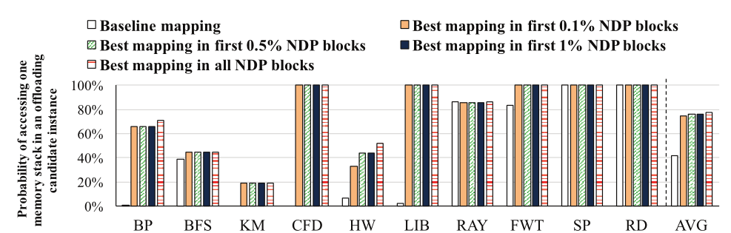
Technique—— Programmer-transparent Data Mapping
Predictability of the best memory mapping
Adjusting memory mapping after data has been placed in GPU memory and during kernel execution can involve high overhead in moving data between stacks and could easily eliminate the benefits of NDP. We find that we can predict the best memory mapping by observing a small number of initial offloading candidate instances’ memory behavior.
Figure 6: Effectiveness of the best memory mapping chosen from different fraction of offloading candidate instances.
The figure shows that the mapping chosen after observing only 0.1% of offloading candidate instances achieves a probability of accessing one memory stack of 72%, which is only 3% less than that obtained with oracle knowledge. We conclude that we can predict a simple memory stack physical address mapping that significantly improves code/data co-location by observing a small number of initial offloading candidate instances.

Slide 14
Technique—— Programmer-transparent Data Mapping
Programmer-transparent data mapping
GPU kernel execution is split into a relatively short initial learning phase followed by regular execution:
1、During the learning phase, all GPU kernels run on the main SMs and the corresponding data resides in the CPU memory while the mechanism learns the best memory mapping for data accessed by offloading candidates. Our mechanism essentially delays the memory copy from the CPU to the GPU in the typical GPU execution flow so there is no extra data remapping overhead.
2、During regular execution, offloaded code runs on memory stack SMs while the data it accesses is mapped using the best mapping discovered in the learning phase.

Slide 15
Technique—— Dynamic Offloading Aggressiveness Control
Dynamic Offloading Aggressiveness Control
Aggressively offloading candidates determined by the compiler to memory stacks may make the system slower in two scenarios:
1、Memory stack SMs could become new performance bottlenecks if the number of offloading requests is more than what they can handle. As each SM has a limit on concurrent warps running on it, the SMs in memory stacks cannot spawn new warps for an offloaded block after the number of concurrent warps reaches the hardware limit.
2、There could be a discrepancy in the bandwidth savings of the RX and TX off-chip links. Offloading a block may save significant bandwidth in the RX channel, but introduce additional traffic in the TX channel. If the TX channel is the performance bottleneck for an application, offloading such a block will exacerbate the problem.
To address the above cases, we propose dynamic offloading aggressiveness control, which uses run-time information to make the final decision on whether or not each candidate should be offloaded.
1、The GPU keeps track of the number of pending offloading requests sent to each memory stack, and stops further offloading when that number reaches the number of warps that can concurrently execute on the corresponding memory stack SM.
2、The GPU monitors the bandwidth utilization of both TX and RX channels, and does not offload blocks that would introduce more traffic to a channel that is already above some threshold utilization rate.

Slide 16
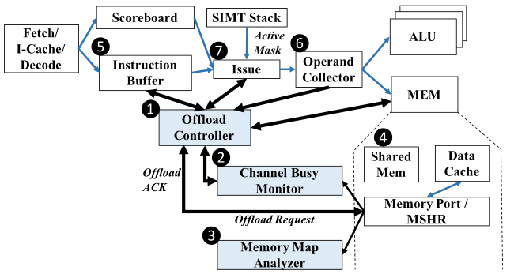
Technique—— Implementation
Hardware Block Diagram
Figure 7: Block diagram of the NDP hardware and its interactions with the GPU pipeline.
We add three new components to support our mechanisms:
(1) An Offload Controller to make final offloading decisions
(2) A Channel Busy Monitor to monitor the utilization of the off-chip channels
(3) A Memory Map Analyzer to support programmer-transparent data mapping.

Slide 17
Technique—— Implementation
Hardware Block Diagram
1、Offload Controller : The Offload Controller works with the main GPU pipeline to provide three functions.:
(1)、It determines whether a candidate block should be offloaded based on runtime information. This runtime decision involves handling of conditional offloading candidates and dynamic offloading aggressiveness control.
(2)、It packs the offloading information and sends it to the memory stack SMs.
(3)、It resumes the offloaded warp when it receives the corresponding acknowledgment packet from memory stack SMs.
2、Channel Busy Monitor : The Channel Busy Monitor tracks the utilization of off-chip TX/RX channels. When the utilization rate of a channel reaches a pre-defined threshold, it reports the channel as busy to the Offload Controller .
3、Memory Map Analyzer : The Memory Map Analyzer is set up by the GPU Runtime to provide the number of memory stacks accessed by each offloading candidate instance for all different potential stack mappings.

Slide 18
Technique—— Design of NDP Offloading
Interface between the compiler and the hardware
(1)、We introduce a new instruction in the ISA that is used by the compiler to indicate the beginning of an offloading candidate block to the hardware.
(2)、The compiler provides an offloading metadata table in the program to the hardware. Each entry in this table is associated with an offloading candidate, and provides the begin/end PC addresses, live-in/live-out registers, 2-bit tags to indicate the TX/RX channel savings, and the condition for conditional offloading candidates. This table is allocated by the compiler and placed in on-chip Shared Memory.
Offloading candidate block detection
In the pipeline, each instruction is decoded and placed into the Instruction Buffer. When the Instruction Buffer detects the instruction as the beginning of an offloading candidate block, it marks this warp as not ready, and consults the Offload Controller for an offloading decision. The Offload Controller fetches its offloading metadata from Shared Memory, and uses it to make an offloading decision.

Slide 19
Technique—— Design of NDP Offloading
Dynamic offloading decision
The dynamic offloading decision consists of three steps:
(1) 、The Offload Controller checks whether the condition for offloading is true for a conditional offloading candidate. It does so by getting the corresponding register value from the Operand Collector and performing the value comparison based on the corresponding condition .
(2) 、If one of the TX/RX channels is signaled as busy by the Channel Busy Monitor and the 2-bit tag for this block indicates that it would introduce more memory traffic to a busy channel, the Offload Controller does not offload it.
(3) 、The Offload Controller determines the offloading destination based on the memory stack that will be accessed by the first instruction of the block. It then checks whether the number of pending offloading requests to that memory stack have reached the warp limit of the memory stack SM, and, if so, skips offloading.
After the decision is made, the warp that is waiting for the offloading decision becomes ready. The Issue unit issues the instructions into the pipeline as usual if the decision is not to offload the block. Otherwise, it sends the instruction to the Offload Controller. The Offload Controller packs live-in registers, begin/end PCs, and active masks as an offloading request and sends it to the memory stack.
When an offloaded block completes its execution on the memory stack, the memory stack SM sends an offload acknowledgment packet to the main GPU, which includes live-out registers and the cache lines that need to be invalidated. The Offload Controller requests cache invalidations and register updates, and then restarts the corresponding warp from the next instruction of the end of the block on the GPU.

Slide 20
Technique—— Design of Programmer-transparent Data Mapping
Software/hardware cooperative mechanism
. In hardware, we add a memory mapping analyzer in the GPU. In software, we modify the GPU host-side driver that runs on the CPU and the GPU run time that runs on the GPU. Existing applications can benefit from our programmer-transparent data mapping without any program modification. This mechanism consists of the following steps:
(1) 、Before launching a GPU kernel, a GPU application needs to allocate memory through the GPU driver on the CPU, and copy corresponding locations from the CPU memory into the GPU memory. With programmer-transparent data mapping, the GPU driver still allocates memory in the GPU virtual memory space, but delays the copy by initially mapping the GPU virtual memory to CPU memory. During the initial learning phase, the GPU driver records each memory allocation in a memory allocation table for further reference.
(2) 、When the application requests a GPU kernel launch, the GPU driver uses the GPU runtime to set up the memory mapping analyzer based on two tables: the memory allocation table from Step 1 and the offloading metadata table from the compiler. The GPU driver then launches the kernel as usual.
(3) 、The memory mapping analyzer monitors the execution of GPU threads and their memory accesses.
(4) 、When the memory mapping analyzer has seen the predetermined number of offloading candidate instances (e.g.,0.1% of all instances) , it issues an interrupt to the GPU runtime. The GPU runtime stops execution on all SMs in the GPU and uses the data recorded by the mapping analyzer to determine the best memory mapping.
(5) 、Finally, the GPU runtime requests the GPU driver on the CPU to perform the memory copy.

Slide 21
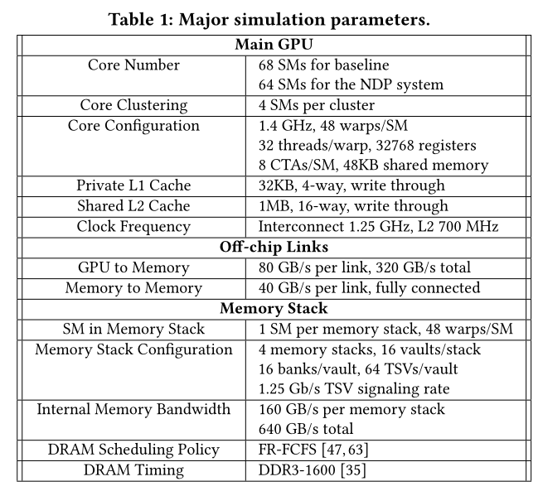
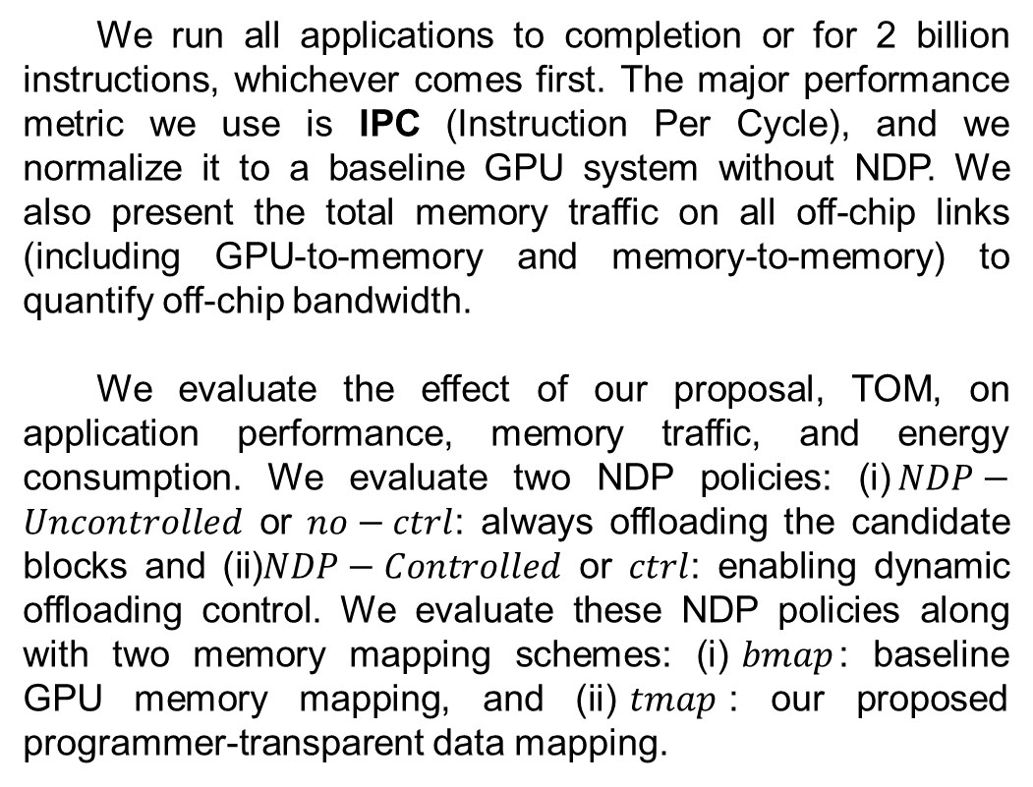
Evaluation
Major simulation parameters
We run all applications to completion or for 2 billion instructions, whichever comes first. The major performance metric we use is IPC (Instruction Per Cycle), and we normalize it to a baseline GPU system without NDP. We also present the total memory traffic on all off-chip links (including GPU-to-memory and memory-to-memory) to quantify off-chip bandwidth.
We evaluate the effect of our proposal, TOM, on application performance, memory traffic, and energy consumption. We evaluate two NDP policies: (i)$NDP−Uncontrolled$ or $no−ctrl$: always offloading the candidate blocks and (ii)$NDP−Controlled$ or $ctrl$: enabling dynamic offloading control. We evaluate these NDP policies along with two memory mapping schemes: (i)$bmap$: baseline GPU memory mapping, and (ii)$tmap$: our proposed programmer-transparent data mapping.

Slide 22
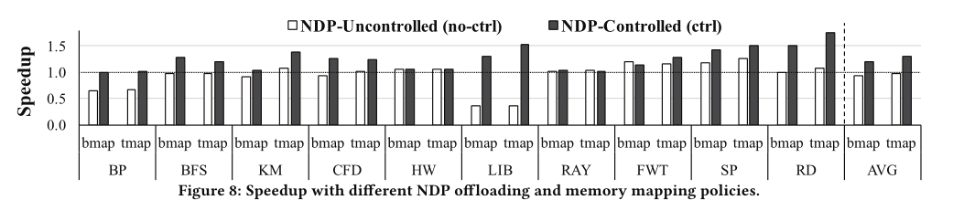
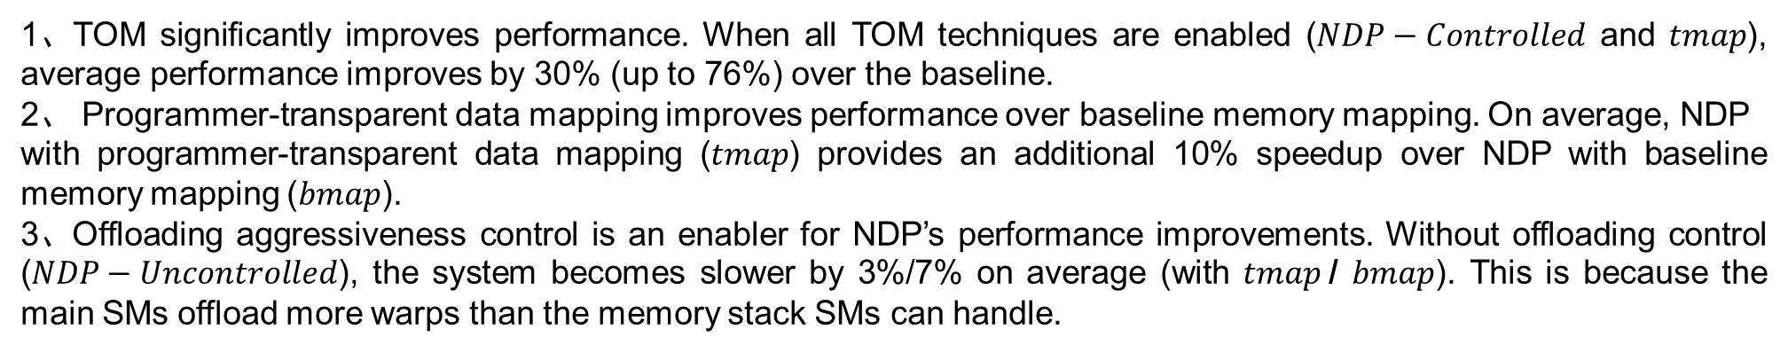
Evaluation
Effect on Performance
1、TOM significantly improves performance. When all TOM techniques are enabled ($NDP−Controlled$ and $tmap$), average performance improves by 30% (up to 76%) over the baseline.
2、 Programmer-transparent data mapping improves performance over baseline memory mapping. On average, NDP
with programmer-transparent data mapping ($tmap$) provides an additional 10% speedup over NDP with baseline memory mapping ($bmap$).
3、Offloading aggressiveness control is an enabler for NDP’s performance improvements. Without offloading control ($NDP−Uncontrolled$), the system becomes slower by 3%/7% on average (with $tmap$/ $bmap$). This is because the main SMs offload more warps than the memory stack SMs can handle.

Slide 23
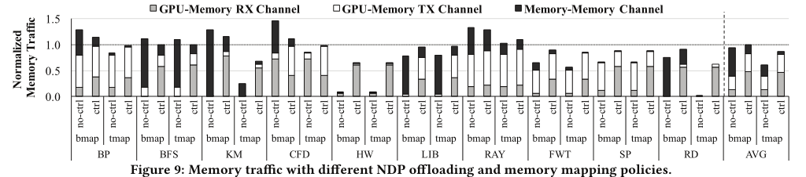
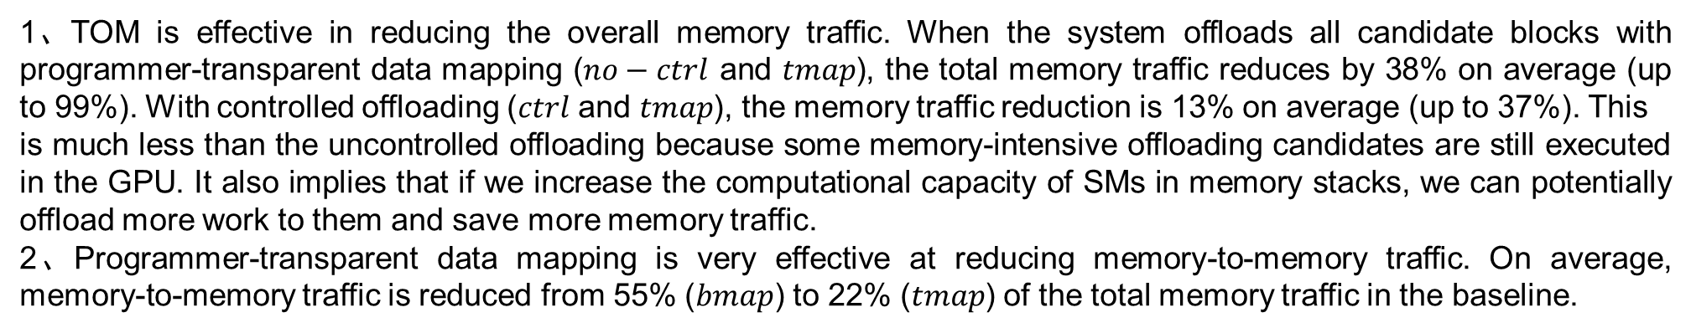
Evaluation
Effect on Memory Traffic
1、TOM is effective in reducing the overall memory traffic. When the system offloads all candidate blocks with programmer-transparent data mapping ($no−ctrl$ and $tmap$), the total memory traffic reduces by 38% on average (up to 99%). With controlled offloading ($ctrl$ and $tmap$), the memory traffic reduction is 13% on average (up to 37%). This
is much less than the uncontrolled offloading because some memory-intensive offloading candidates are still executed in the GPU. It also implies that if we increase the computational capacity of SMs in memory stacks, we can potentially offload more work to them and save more memory traffic.
2、Programmer-transparent data mapping is very effective at reducing memory-to-memory traffic. On average, memory-to-memory traffic is reduced from 55% ($bmap$) to 22% ($tmap$) of the total memory traffic in the baseline.

Slide 24
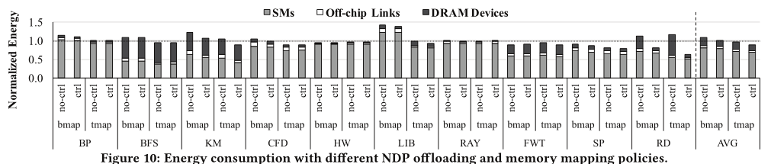
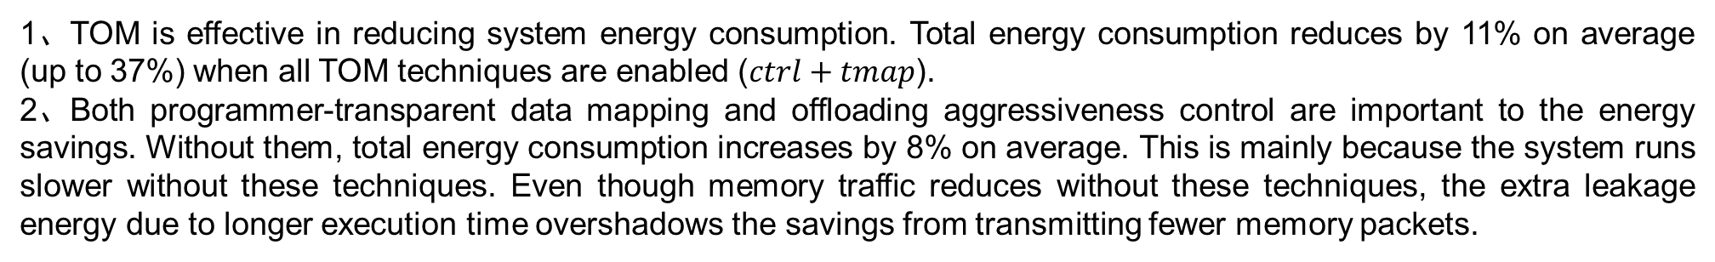
Evaluation
Effect on Energy Consumption
1、TOM is effective in reducing system energy consumption. Total energy consumption reduces by 11% on average (up to 37%) when all TOM techniques are enabled ($ctrl+tmap$).
2、Both programmer-transparent data mapping and offloading aggressiveness control are important to the energy savings. Without them, total energy consumption increases by 8% on average. This is mainly because the system runs slower without these techniques. Even though memory traffic reduces without these techniques, the extra leakage energy due to longer execution time overshadows the savings from transmitting fewer memory packets.

Slide 25
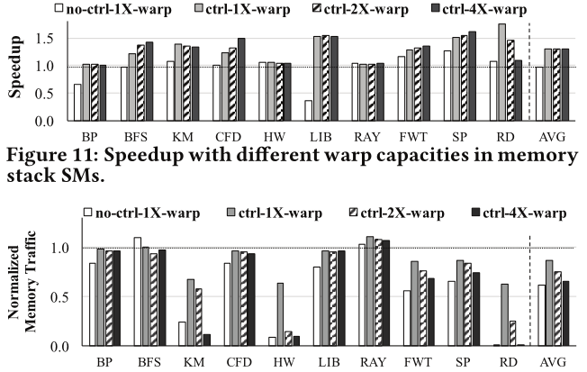
Evaluation
Sensitivity to Computational Capacity of SMs in Memory Stacks
Figure 12: Memory traffic with different warp capacities in memory stack SMs
The memory traffic savings with 4×warp capacity is 34% compared to the baseline, which is close to the 38% traffic reduction from uncontrolled offloading. Performance also improves by 29% with 4×warp capacity compared to the baseline, and most workloads have better performance than with 1×warp capacity.

Slide 26
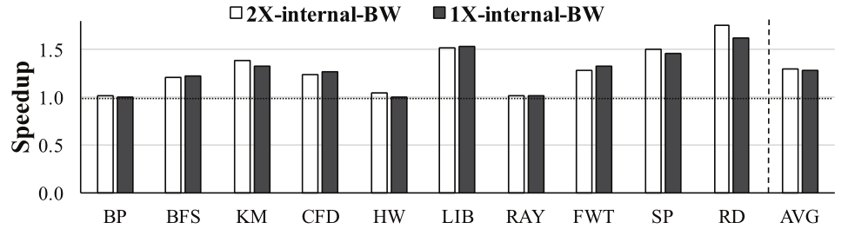
Evaluation
Sensitivity to Internal and Cross-Stack Memory Bandwidth
Figure 13: Speedup with different internal bandwidth in memory stacks.
As such, the performance of our NDP architecture does not hinge on higher internal bandwidth. The reason is that the main GPU is usually bottlenecked by one of the TX/RX off-chip channels.

Slide 27

Thank You!

